Slide 1
PRESENT WORTH AND FUTURE WORTH ANALYSIS
Basis for Comparison of Alternatives

Slide 2
Conditions For Using Cash Flow Approach
Cash flows are known
Cash flows are in constant value rupees
The interest rate is known
Comparisons are made with before tax cash flows
Comparisons do not include intangible consideration
Comparison do not include consideration of availability of funds to implement alternatives.

Slide 3
Revenue dominated cash flows
Example 1:
The details of the feasibility report of a project are shown below. Check the feasibility of the project based on Present Worth Method if i=20%.
Initial outlay- Rs.50,00,000
Life of Project- 20 years
Annual Equivalent Revenues- Rs.15,00,000
Modernizing cost at the end of 10th year- Rs.20,00,000
Salvage value at the end of project life- Rs.5,00,000

Slide 4
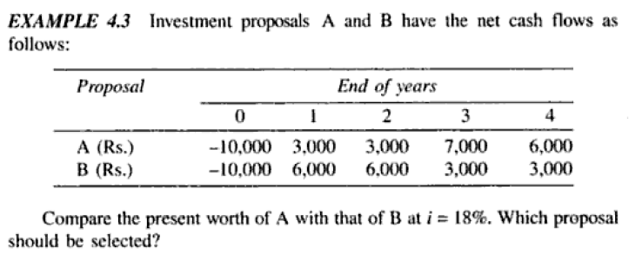
Example 3

Slide 5
Cash Dominated cash flows

Slide 6
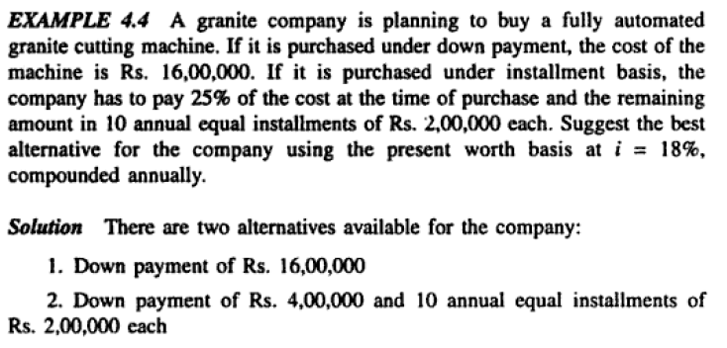
Example 4

Slide 7
Comparison of Assets Having Unequal Lives
Common multiple method (LCM)
Assets A1 and A2 have the capability of satisfactorily performing a required function. Asset A2 has an initial cost of Rs.32000 and an expected salvage value of Rs.4000 at the end of its 4 years service life. Assets A1 costs 9000 less initially, with an economic life 1 year shorter than that of A2; but A1 has no salvage value, and its annual operating costs exceed those of A2 by 2500. When the required rate of return is 15% state which alternative is preferred.

Slide 8
Study period
A new rock pit will be operated for a construction project that will last 5 years. Rock can be loaded from an elevated box loader served by a conveyor from the pit or by mobile shovel loaders.
The box loader and conveyor have an initial cost of Rs.2,64,000 and will have no salvage value at the end of the project.
Two shovel loaders each priced Rs.42,000 can provide the same capacity, but their operating costs together will be Rs.36,000 per year more than the box loader. Normal service life for a shovel loader is 3 years with zero salvage value, but a 2 year old machine can likely be sold for Rs.10,000. which alternative is preferred when the interest rate is 13%?

Slide 9

Example 7: Two types of trucks are available for transportation use. They are needed for 10 years. The details are.
 | Truck A | Truck B
First cost | 10,00,000 | 15,00,000
Estimated annual maintenance cost | 20,000 | 15,000
Estimated life | 5 years | 10 years
Estimated salvage value | 2,00,000 | 5,00,000
Both truck deliver the same amount of work. Assume interest rate of 7% compounded semiannually. Which truck is to be preferred on PW basis. Use CFD for analysis.
For the same numerical compare the alternatives using Future Worth Method.

Slide 10
Example 8
An entrepreneur intending to start a new business knows that the first few years are the most difficult.
To lessen the chance of failure, a loan plan for start up capital is proposed in which interest paid during the first two years will be at 3% and at 6% for the next two years of the 6 years loan.
How large a loan can be justified for proposed repayments at the end of years 2,4,and 6 respectively Rs. 20,000 , Rs. 30,000 and Rs.50,000?

